Slide 1
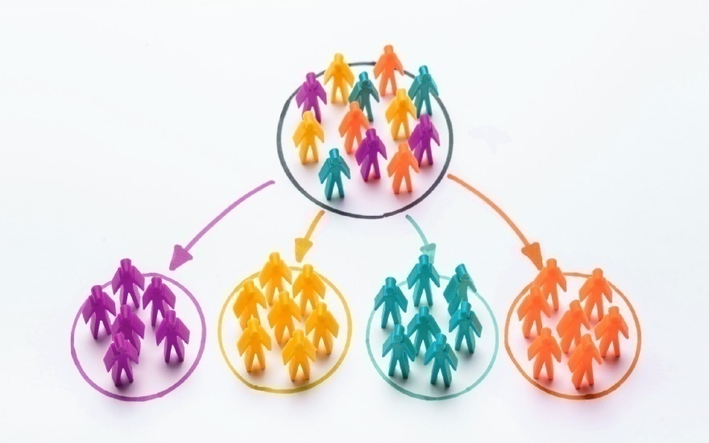
Market Segmentation
Market Segmentation is the process of dividing a market of potential customers into groups, or segments, based on different characteristics
The SEGMENTS thus created are composed of consumers who will respond similarly to marketing strategies and who share traits such as similar interests, needs, or locations
`

Slide 2
BasIs of market segmentation
DEMOGRAPHIC : It consist of dividing the market into groups based on variables such as ;
Age
Gender
Income
Social Class
Lifestyle
GEOGRAPHIC : It tries to divide markets into different geographical units ;
Regions
Size of the Area
Population Density
Climate

Slide 3
PSYCHOGRAPHIC : It groups costumer according to their lifestyle . Activities , interest and opinion surveys are one tool for measuring lifestyle ;
Activities
Interests
Opinions
Values
BEHAVIORAL : It is based on actual customer behavior towards products . Some behavioral variable include ;
Opinions , Interests and Hobbies
Degree of Loyalty
Occasions
Usage

Slide 4
Process of market segmentation
Identify Total Market
Divide Total Market into Sub Market
Estimate Sales Potential and Profit for Sub Market
Determine Characteristics and Requirement of Sub Market
Select one or more Segment on which firms will focus on Serving

Slide 5
Requirement for effective segmentation
Measurable : Size, purchasing power, profiles of segments can be measured
Accessible : Segments can be effectively reached and served
Substantial : Segments are large or profitable enough to serve
Differentiable : Segments must respond differently to different marketing mix element and programs
Actionable : Effective programs can be designed to attract and serve the segments

Slide 6
Niche marketing
The word ‘NICHE’ is defined as ;
“A special area of demand for a product or service”
Marketing is defined as the opportunity to buy or sell
NICHE Marketing means buying or selling a product or service in a specialized area of demand
Often-a-times Big Business use NICHE Marketing

Slide 7

Segmenting consumer market
Purchase Occasion
Behavior
Brand Loyalty
User Status
Lifestyle
Psychographic
Personality
Gender
Consumer Segmentation
Demographic
Income
Age
Regions
Geographic
Cities

Slide 8
Business marketing segmentation
Business Markets
Geographic Location
Culture
Behavioral
Business Description

Slide 9


Slide 10
Segmentation is based on the idea that the market is Heterogeneous
True
False

Slide 11
Basis of ‘Segmentation’ are divided into ___ types
5
6
4
3

Slide 12
Lifestyle is an example of which type of Segmentation Variable ?
Psychographic
Demographic
Geo-demographic
Behavioral

Slide 13
What is the marketing term for a relatively small, well-defined and a very focused target market ?
Customized Market
Target Market
Niche Market
Corner of the Market

Slide 14
Age, Gender, Income, and Family Life Cycle all are found in ___ Segmentation.
Behavioral
Psychographic
Geographic
Demographic

Slide 15
Thank you…

